Slide 1

Load Forecasting
Applied Time Series Analysis
Karan Saxena
USC ID: 2102-1579-09

Slide 2
Business Problem
1

Slide 3
Business Problem
To Accurately Predict the demand for Electricity
Maximize Profit by buying the correct price for Electricity.
Prevent the risk of buying electricity in real time at a higher price.

Slide 4
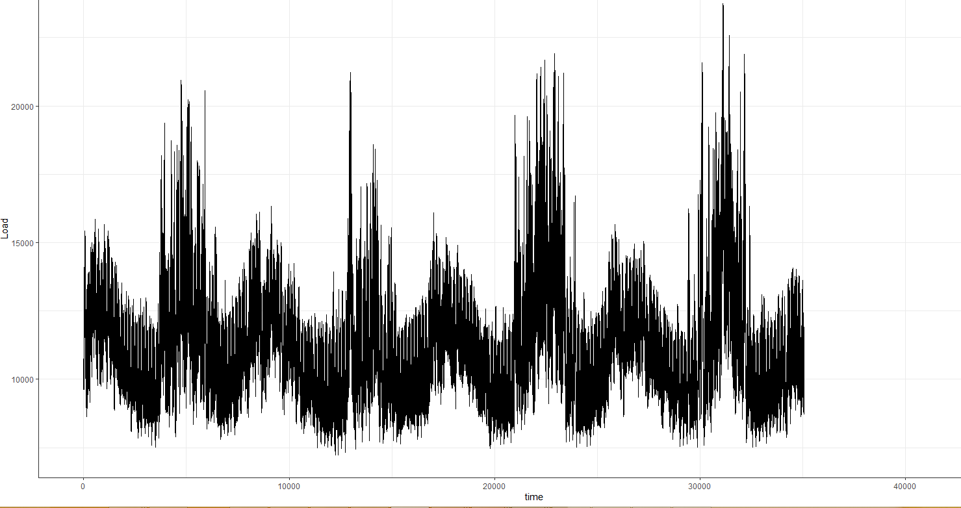
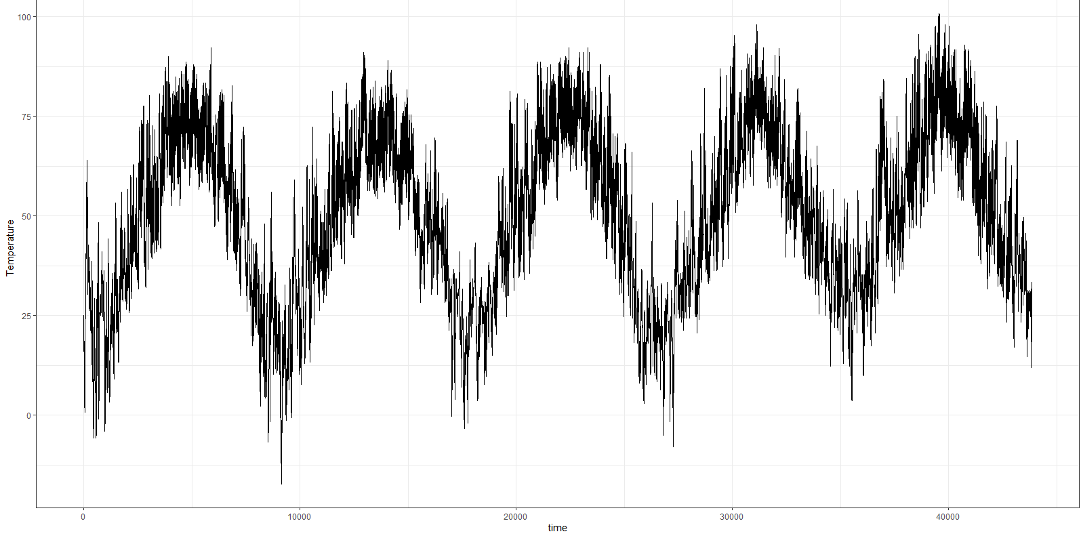
Load Vs Temp
Annual Seasonality
Monthly Seasonality
Weekly Seasonality
Daily Seasonality

Slide 5
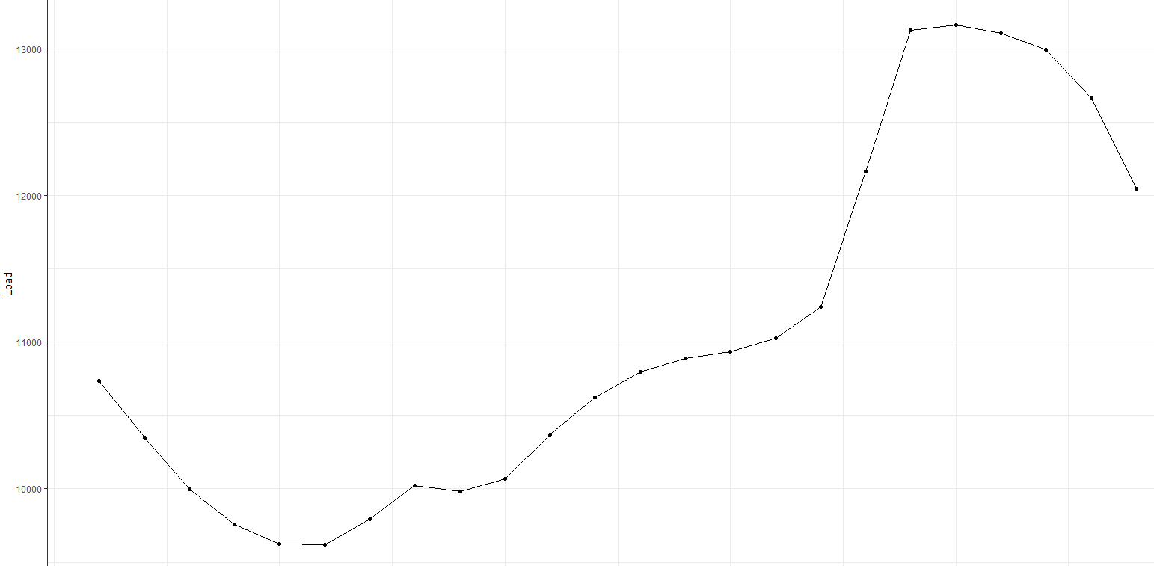
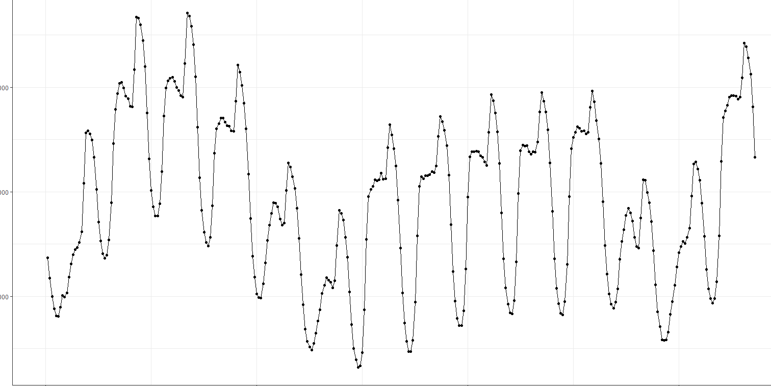
One Day Vs Two Weeks
Two Weeks
One Day

Slide 6
Models
2

Slide 7
Models Explored
1) Multiple Linear Regression
2) Multi Seasonal Time Series
-ARIMA
-ETS
-Naïve
3) Seasonal Naïve
4) Prophet
5) Neural Nets
Training Period
2008-2010
Testing Period
2011

Slide 8

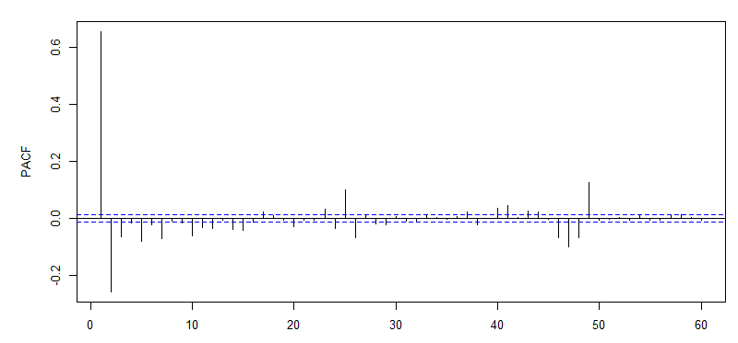
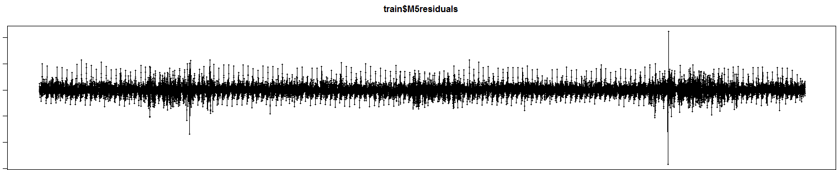
Multiple Linear Regression
Adjusted- R-squared-> 0.9937
MAPE Testing Set -> 2.886

Slide 9
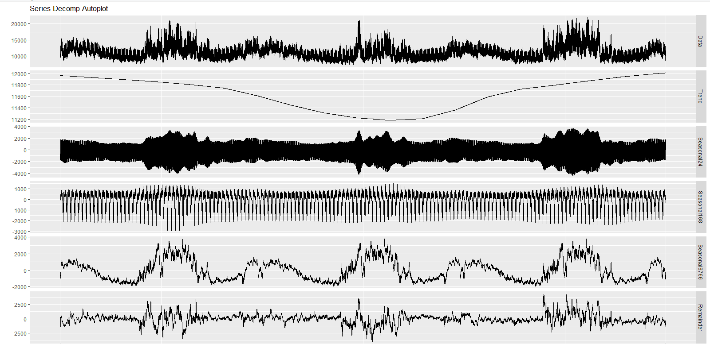
Multi Seasonality Decomposition

Slide 10
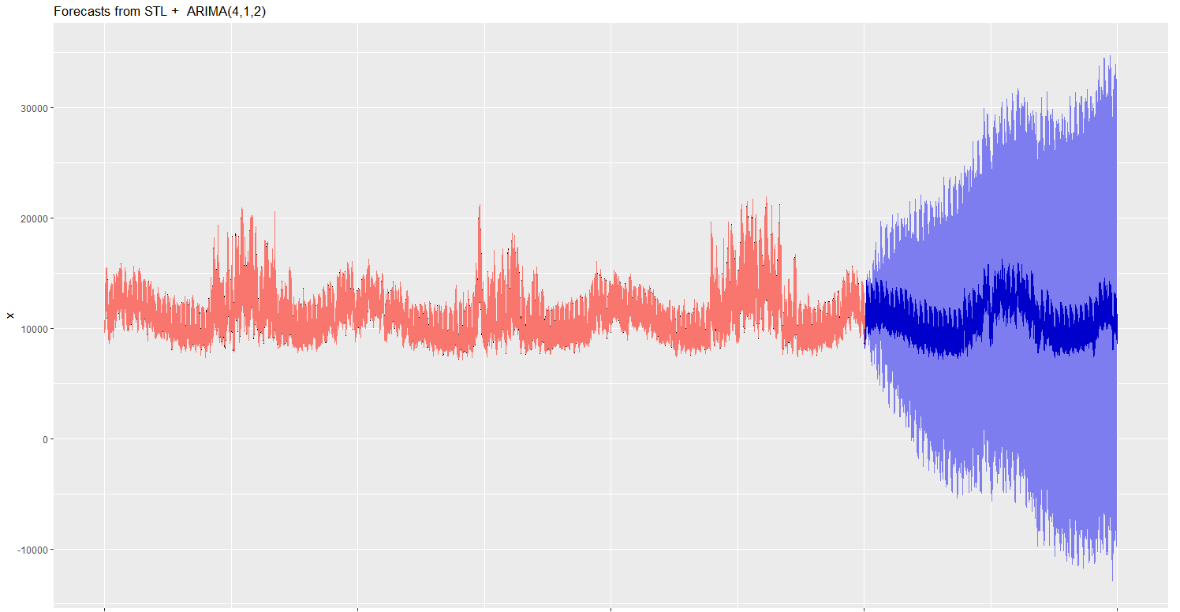
Multi Seasonality- Arima Model

Slide 11
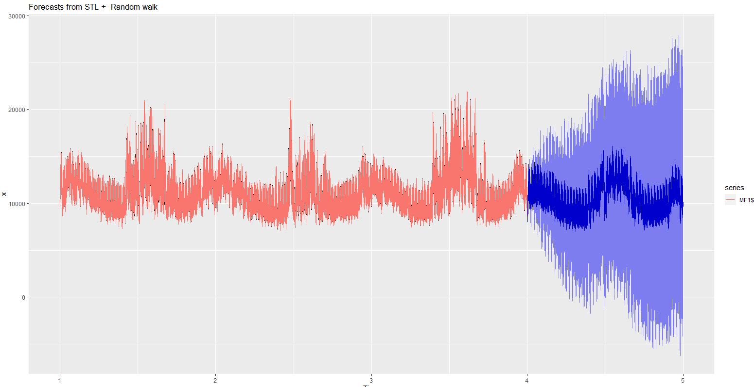
Multi Seasonality- Naïve Model

Slide 12
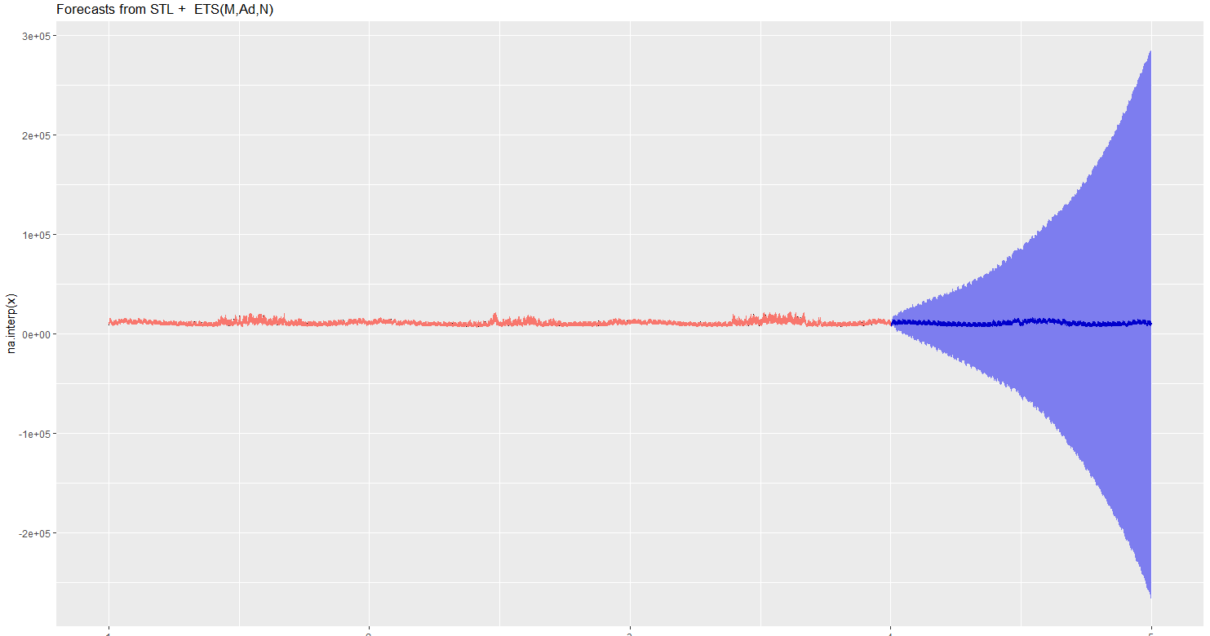
Multi Seasonality- ETS Model

Slide 13
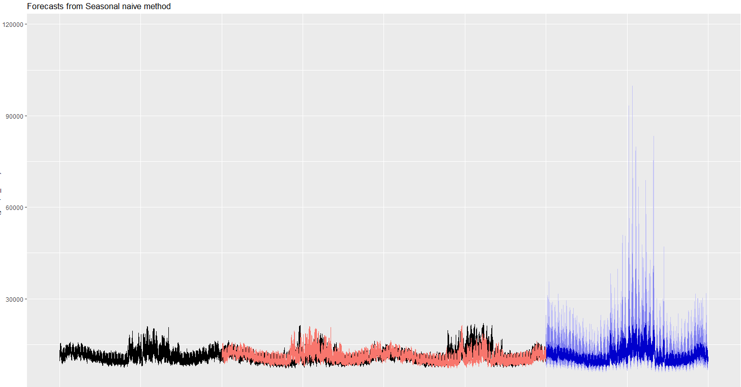
Seasonal Naïve Model

Slide 14
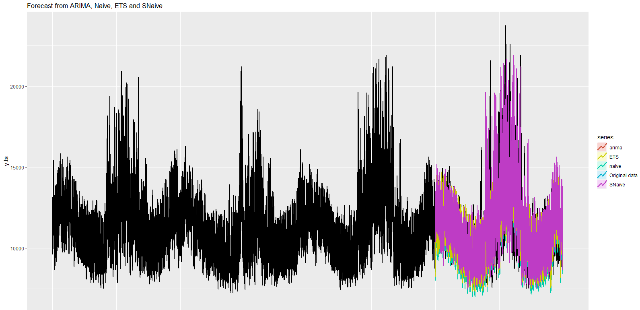
Accuracy Comparison Graph

Slide 15
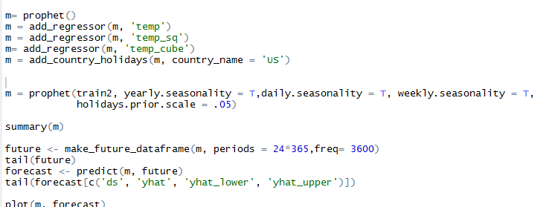
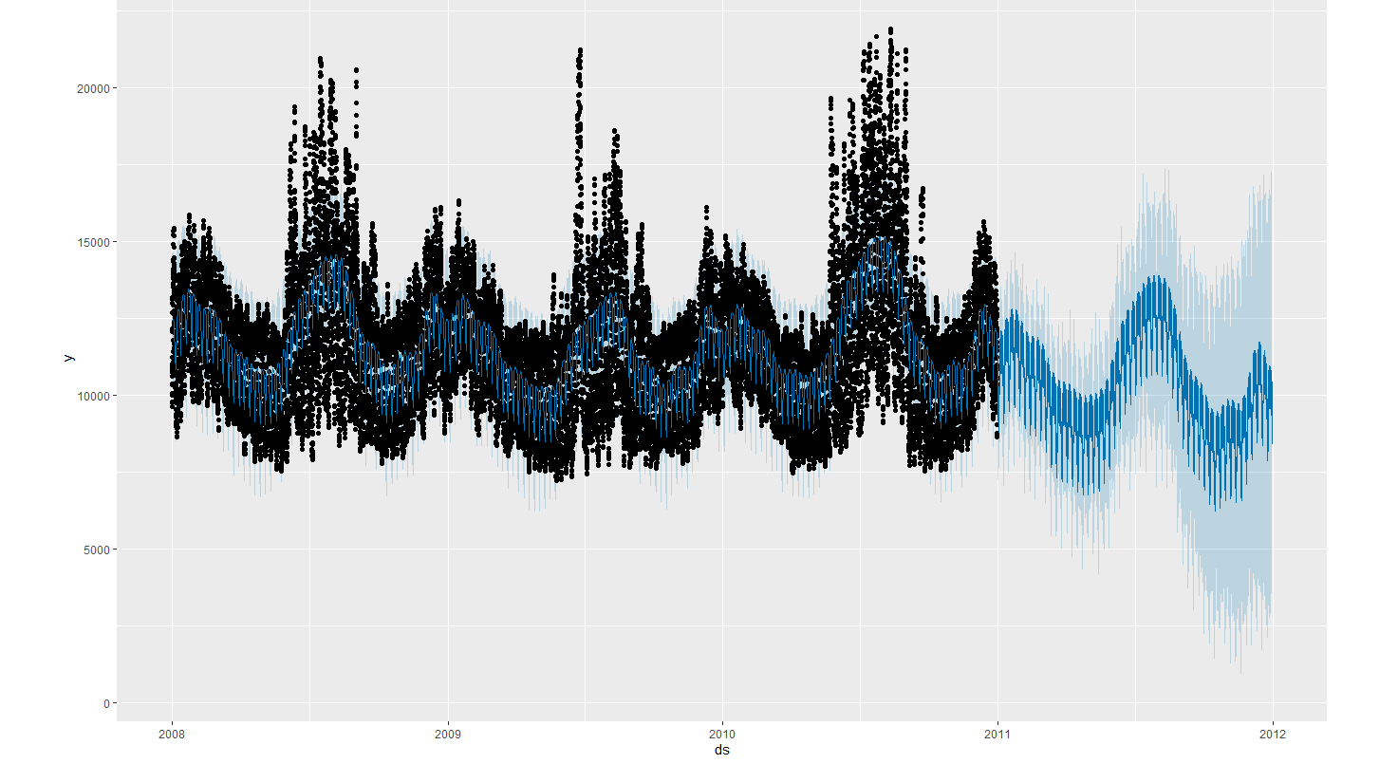
Prophet Model

Slide 16
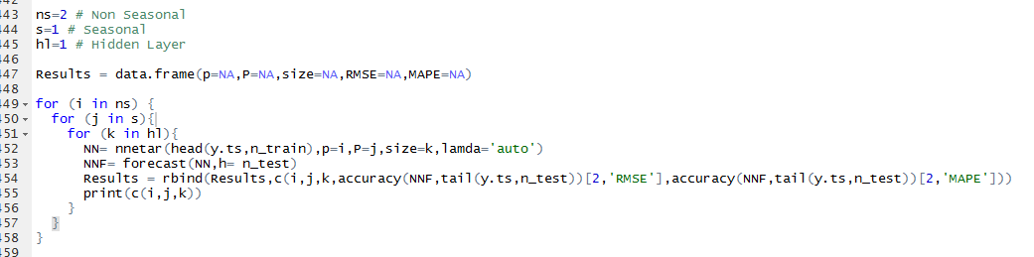
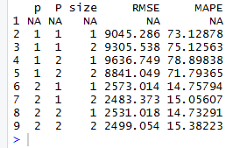
Neural Net Modelling

Slide 17
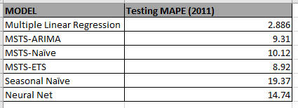
MAPE All Model Testing Set(2011)
Champion Model is Regression

Slide 18
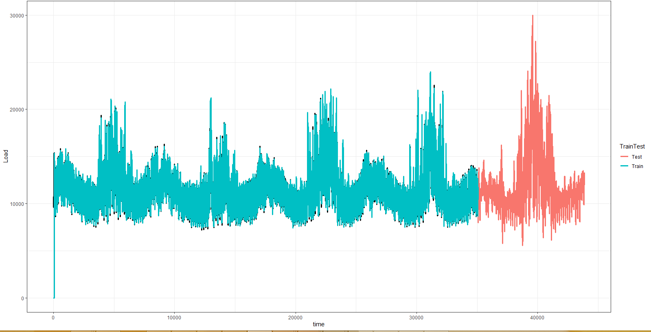
Champion Model Forecast- Regression

